Slide 1







Searching for partially observable problems

Slide 2








Components of partially observable problems
Problem formulation is the same as sensorless problems, except the transition model
1. State prediction:
2. State update:

Slide 3
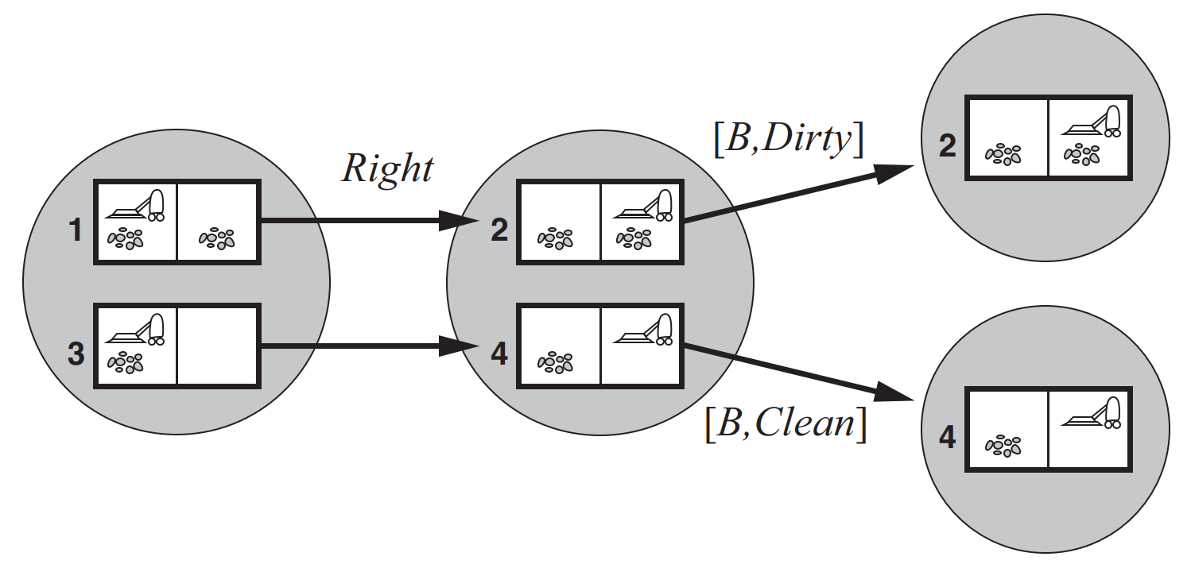



Example
Source: (Russell, 2016)

Slide 4
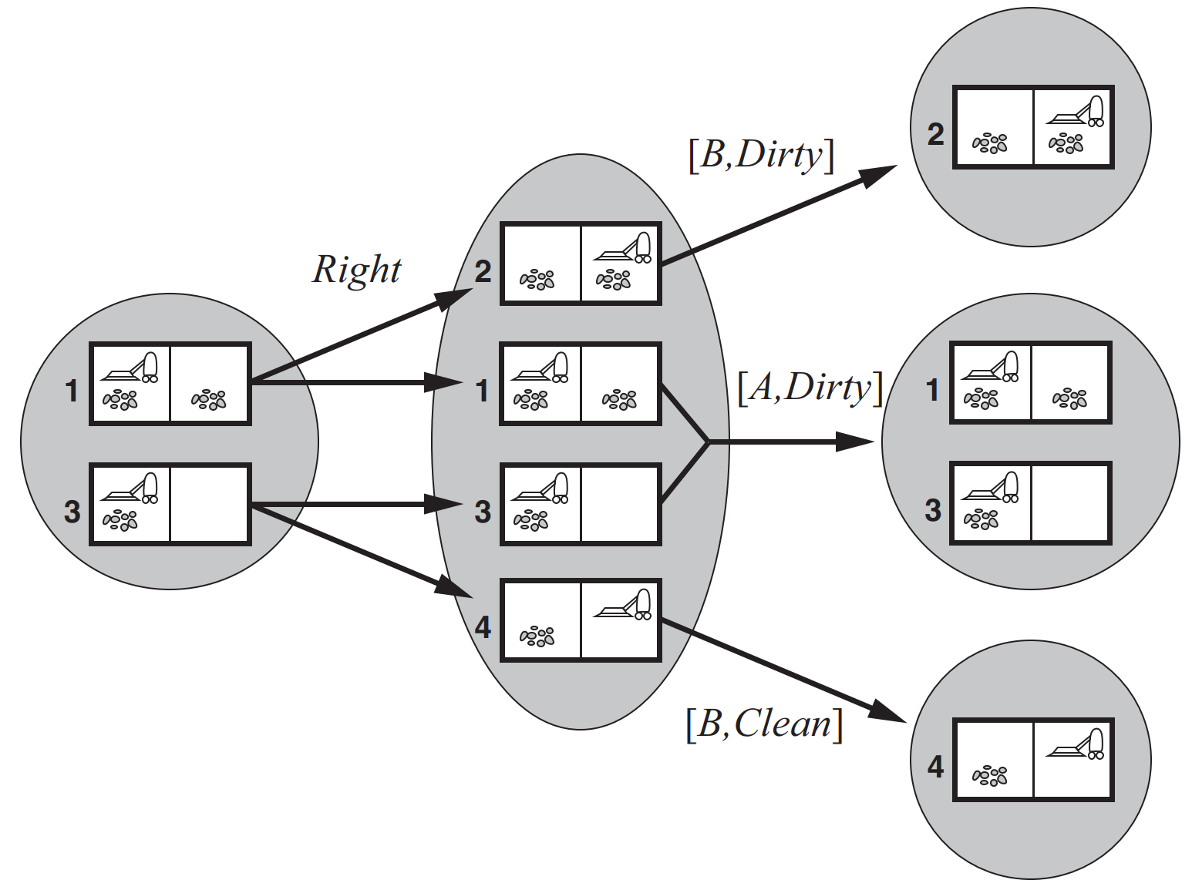





Example
Source: (Russell, 2016)

Slide 5
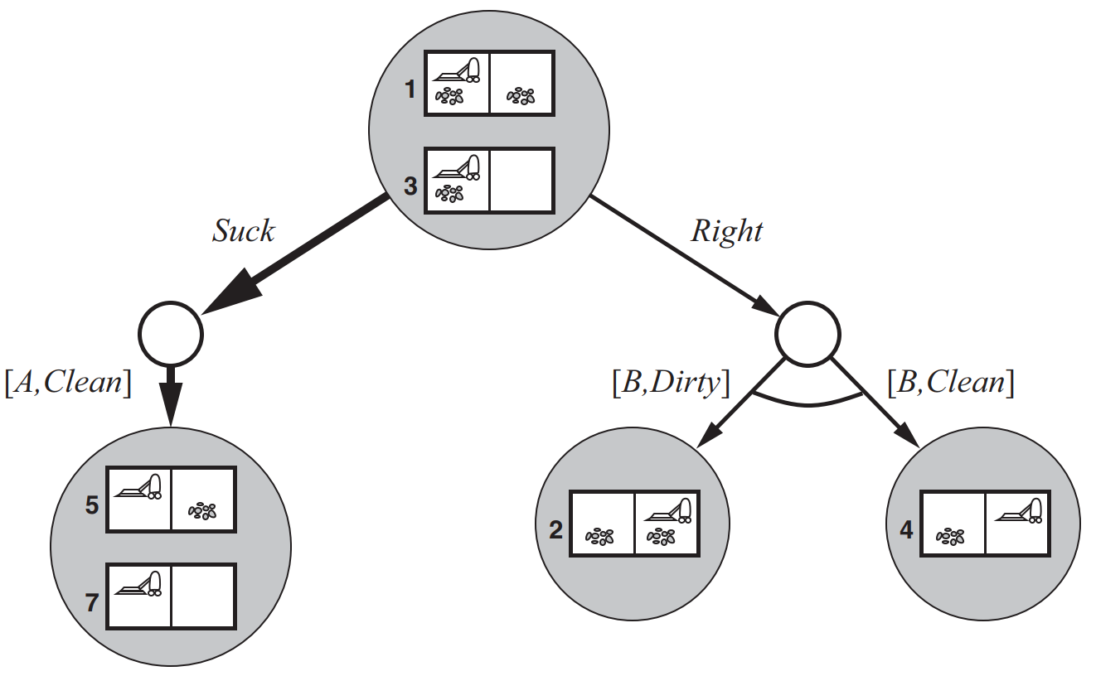




Apply any search algorithm on the belief state space to solve the partially observable problem.
Source: (Russell, 2016)

Slide 6
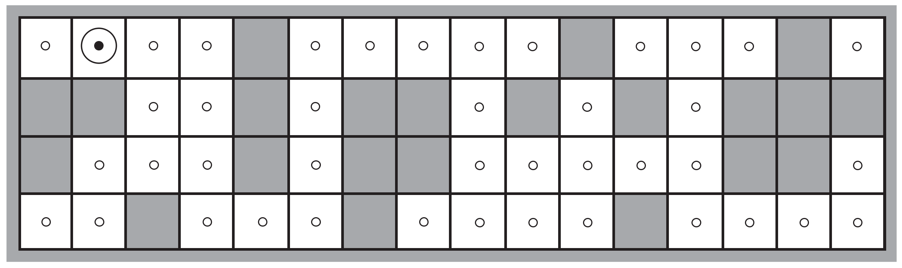






Example: Localization robot
Given a map.
Robot has only 4 sonar sensors:
Image: (Russell, 2016)
To know where it is, the robot needs to

Slide 7
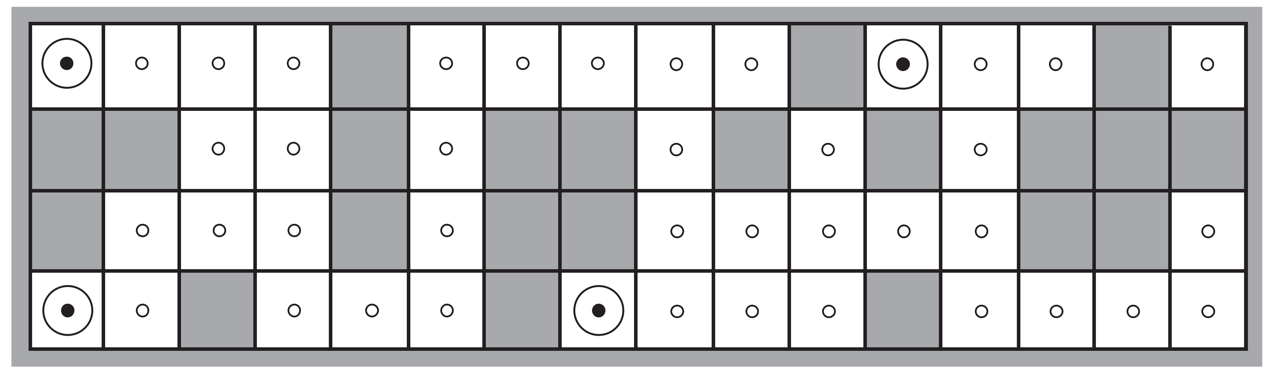





Initial belief state:
After a move, it observes
➔
Image: (Russell, 2016)

Slide 8























After the 2nd move, it observes
➔
Image: (Russell, 2016)

Slide 9
SEARCHING WITH NO TRANSITION MODEL – ONLINE SEARCH

Slide 10










Offline vs. online search
1. Initial state
2. Possible actions: ACTIONS
3. Transition model: RESULT
4. Goal test: GOAL-TEST
5. Cost: STEP-COST, PATH-COST
Offline search: With the transition model, we can
Online search: Without the transition model, we need to

Slide 11


Online search is useful in
There is a penalty for
Nondeterministic environments:
No environment model:
Examples of online search:

Slide 12







Competitive ratio
There are 2 types of path costs in online search:
Actual path cost:
Shortest path cost:
Competitive ratio = Actual path cost / Shortest path cost

Slide 13





Dead-end state
Some actions are irreversible, they lead to a dead-end state:
➔
For example,
Safely explorable state space:
For example,

Slide 14
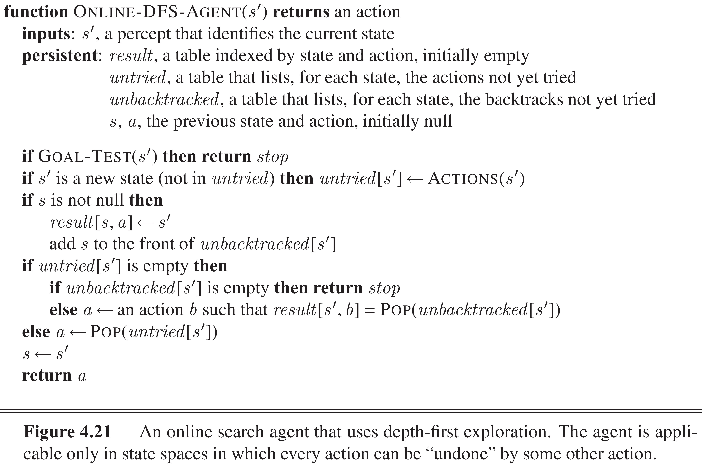



























Online depth-first search agent
Source: (Russell, 2016)

Slide 15








Why depth-first?
In online search: the agent actually walks in the environment. ➔
In depth-first search: the agent only moves to its next position (with 1 or a few actions)
However,
➔

Slide 16




















Online A* search: LRTA* (Learning Real-Time A*) algorithm
Ideas:
At each step, from state s, agent moves to the successor s’ which has the best estimated cost:
H(s):

Slide 17
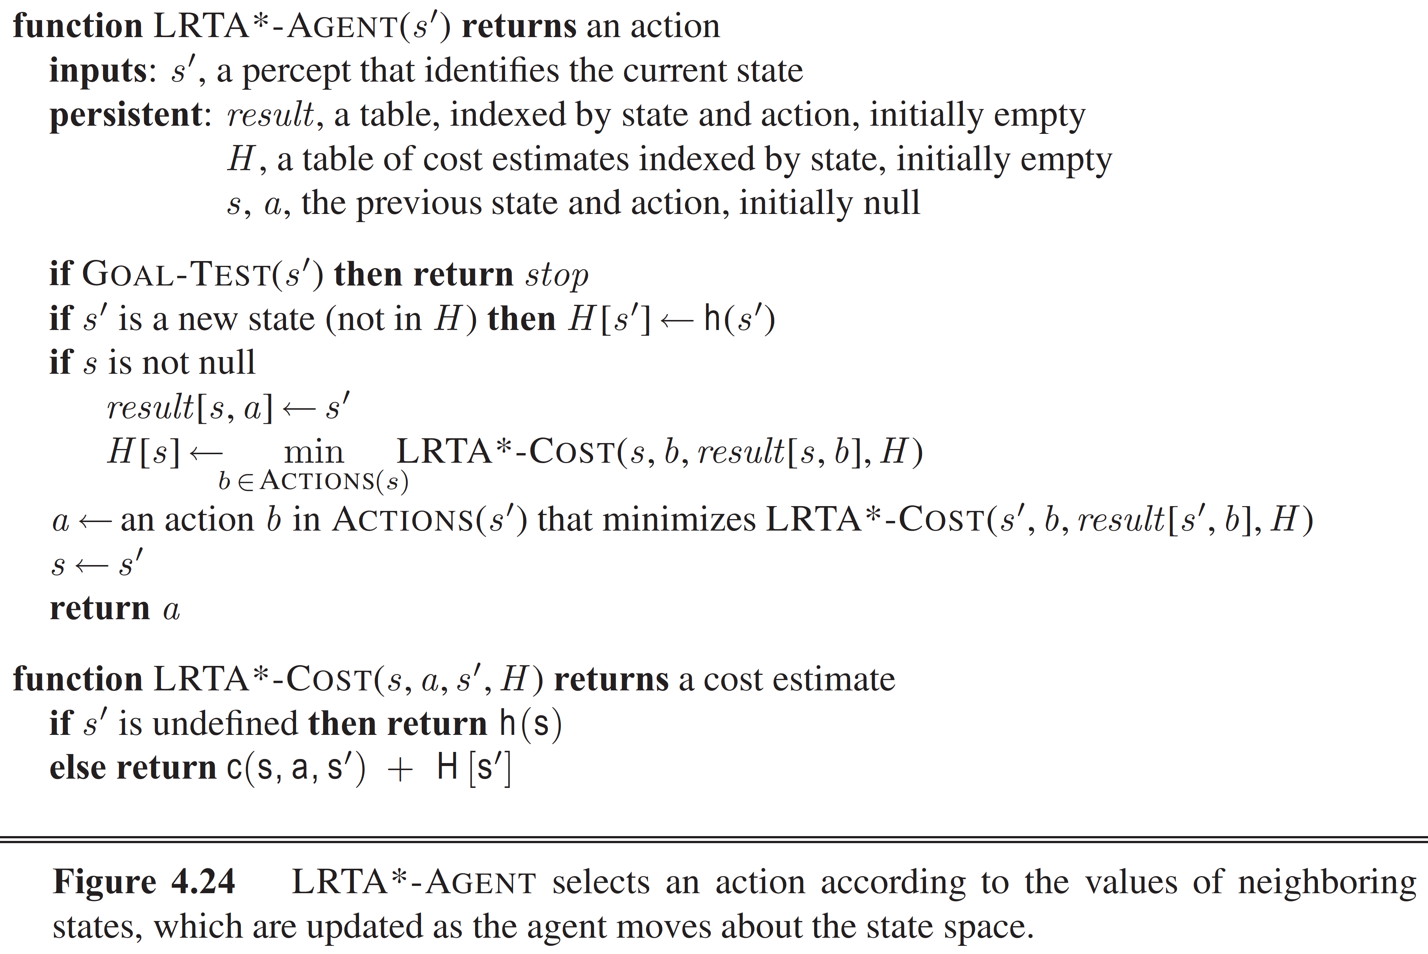









Learning Real-Time A* agent
Source: (Russell, 2016)

Slide 18
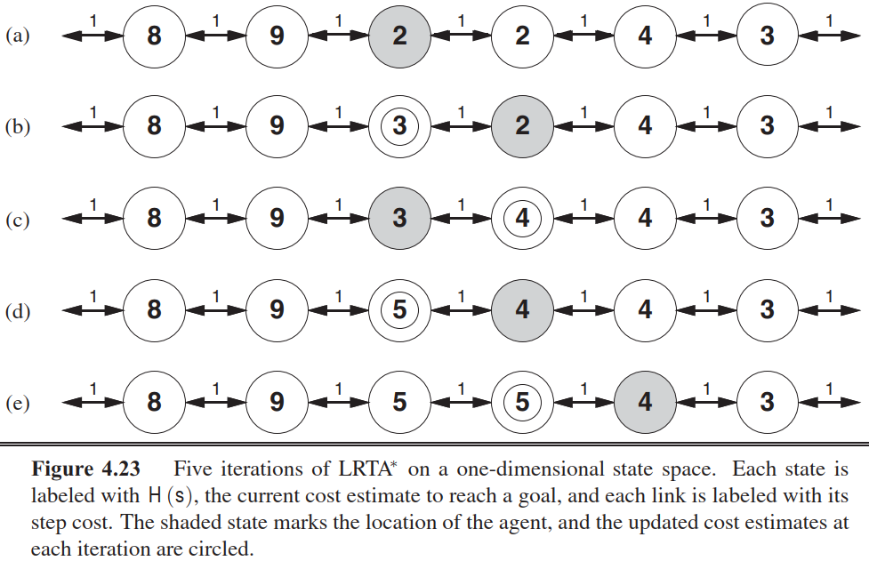




Demo
Source: (Russell, 2016)

Slide 19



NOTE:

Slide 20
CONSTRAINT SATISFACTION PROBLEMS
Main reference:
Chapters 6 of Russell, S., & Norvig, P. (2016). Artificial intelligence: a modern approach.

Slide 21

















Constraint satisfaction problems (CSP)
Previous algorithms use atomic state representation:
Now, we move to factored representation:
Constraint satisfaction problems:

Slide 22








Defining a CSP
Three components:
X:
D:
C:
A solution of a CSP:

Slide 23
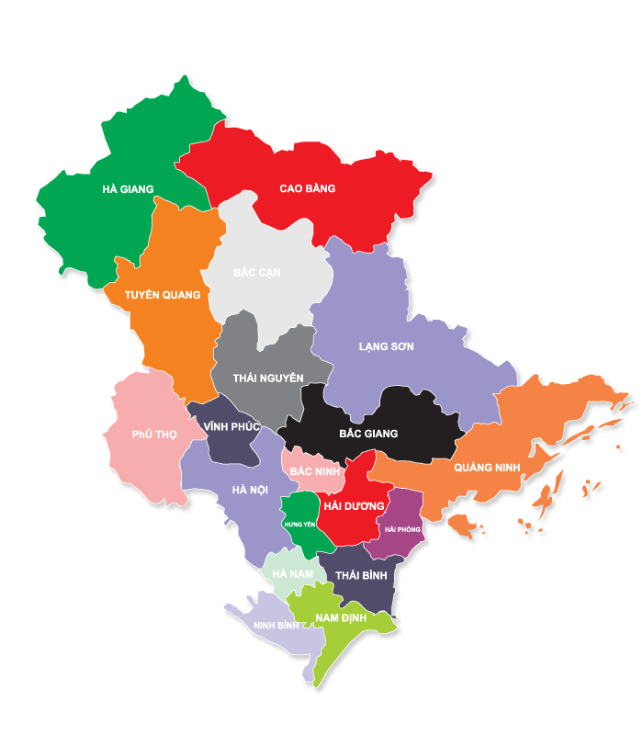











Example: Map coloring problem
Problem: color each region
Problem components:
Image: pngwave

Slide 24
Example 2: Car assembly scheduling
Factories have the problem of job scheduling, subject to various constraints.
For example,

Slide 25




















Example 2: Car assembly scheduling
Problem components:
Variables:
Domains:
Constraints:

